Slide 1
ONLINE PAYMENT FRAUD DETECTION USING MACHINE LEARNING BY Lakshman Chaudhary

Slide 2
TABLE OF CONTENTS
INTRODUCTION
EXECUTIVE SUMMARY
VISUALIZATIONS/INTERPRETATION
MODEL EVALUATION
CONCLUSION/ RECOMMENDATION

Slide 3
INTRODUCTION
Fraud detection is defined as a process that detects scams and prevents fraudsters from obtaining money or property through false means. Fraud is a serious business risk that needs to be identified and mitigated in time.

Slide 4
EXECUTIVE SUMMARY
Bank plc wants to build a machine learning model that will predict online payment fraud. The aim of this project was to develop a model that will predict online payment fraud.
Methods
Information's about the transactions carried out by different customers in the bank were recorded in rows and columns. The data was collected, processed, and statistical analysis was done on the dataset. We also did data verification where we checked if we had any missing values and also checked data type.
Exploratory Data Analysis was carried out on the dataset for proper visualization and understanding where we performed univariate, bivariate and multivariate analysis as much as its feasible. We explored correlation where it shows the relationships between variables(features) and how close they are related to each other.
Feature engineering was done on the dataset where we performed one-hot encoding on categorical variables in preparation for building machine learning models for the prediction.
Four machine learning algorithms were used to train and test the dataset after which they were evaluated using different metrics for best performance and deployment. We selected our models and target variable. The algorithms used were Logistic Regression, Random Forest, Decision Tree and K-Nearest Neighbors. We trained the dataset on 80% while testing on 20%.Both the Decision Tree and Random Forest models outperform the Logistic Regression and K-Nearest Neighbors model by a wide margin. Since they both have similar recall scores, we performed a cross-validation of the two models so we may declare which is the best performer with more certainty. Out of the 4 Machine Learning Models, Random Forest performs best with prediction accuracy 99.97% and recall accuracy 87% which is important for our problem statement where false negative is our priority. Hence, it should be deployed by Bank.
Customers transaction Dataset
Dataset collection &business understanding
Data pre-processing
Model selection and training
Exploratory Data Analysis

Slide 5
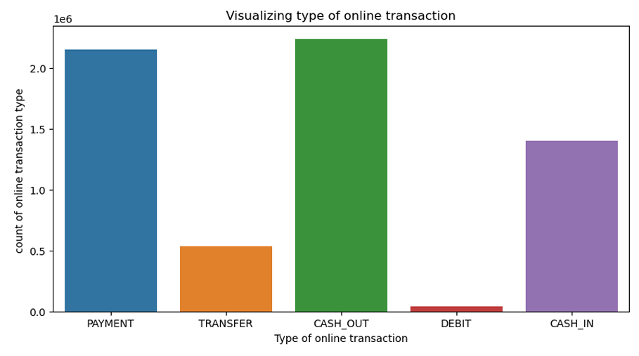
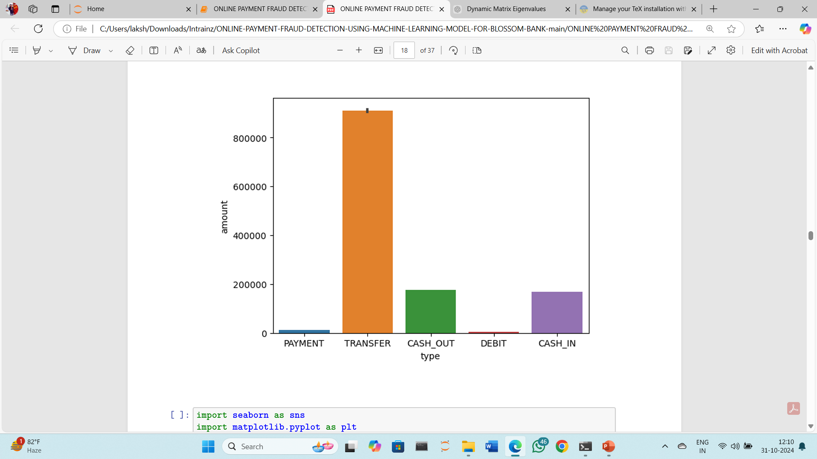
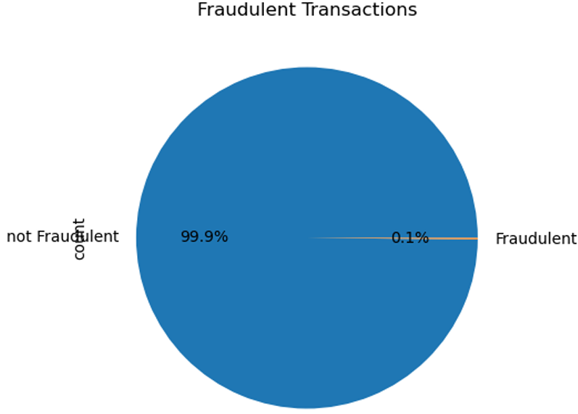
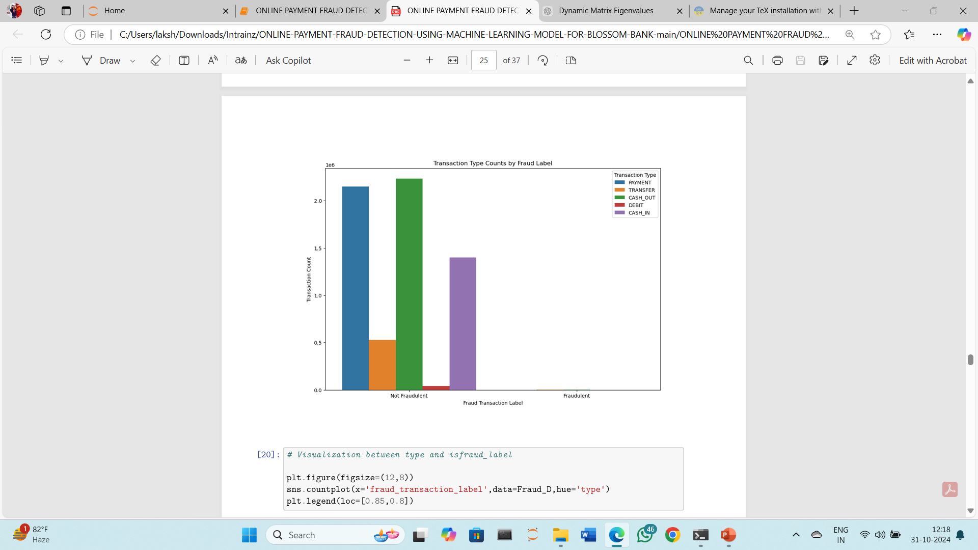
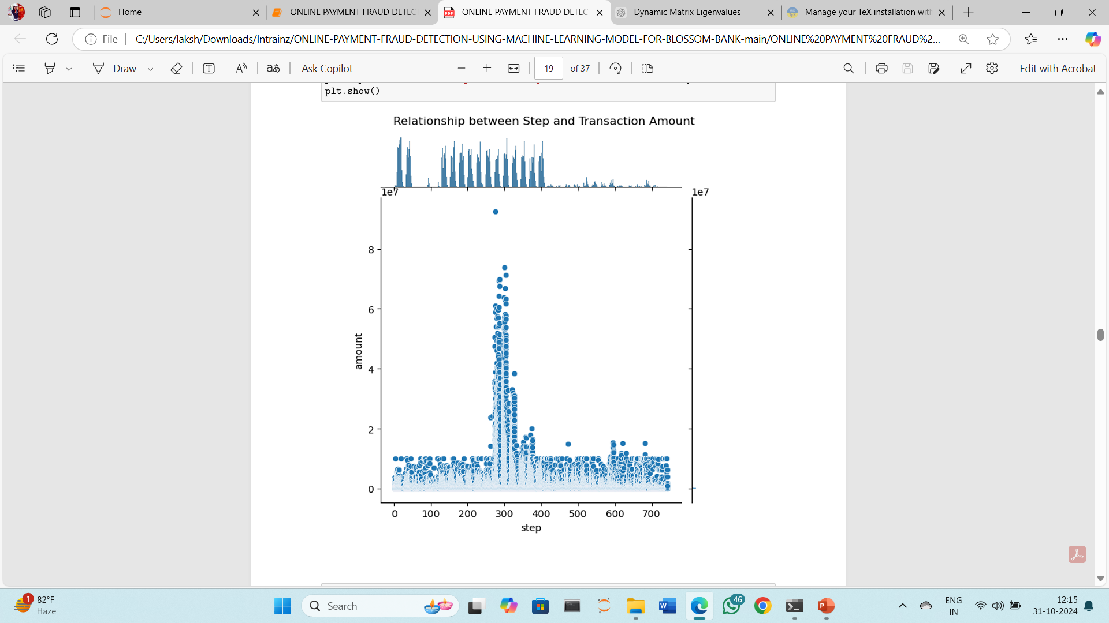
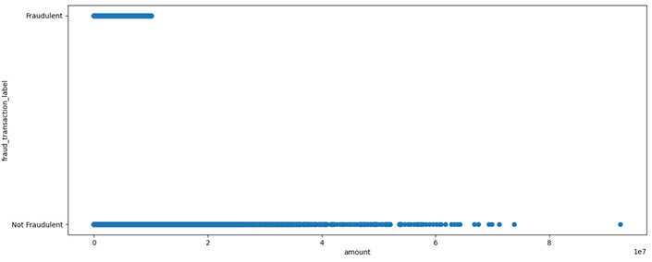
VISUALIZATIONS
In this chart, 'transfer' type has the maximum amount of money being transferred from customers to the recipient. Although 'cash out' and 'payment' are the most common type of transactions
From this chart, its shows that most of the online transactions customers does is not fraudulent. Also the dataset is not balance
From the chart, it is seen that cash_out and payment is the most common type of online transaction that customers use.
Both the above graphs indicate that transactions of the type 'transfer' and 'cash out' comprise fraudulent transactions
The above graph indicates the distribution of the step column
Although the amount of fraudulent transactions is very low, majority of them are constituted within 0 and 10,000,000 amount

Slide 6
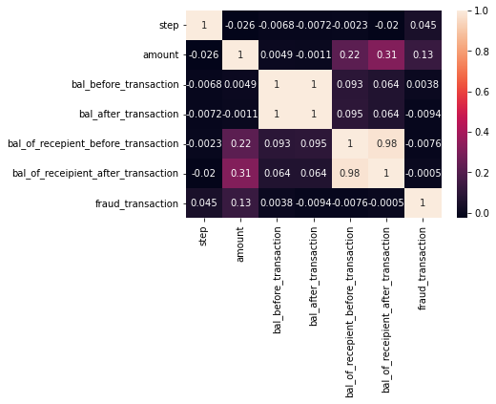
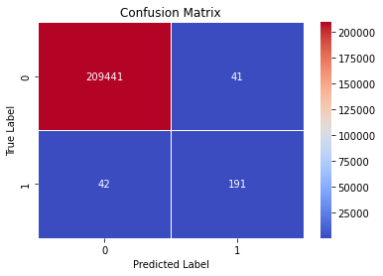

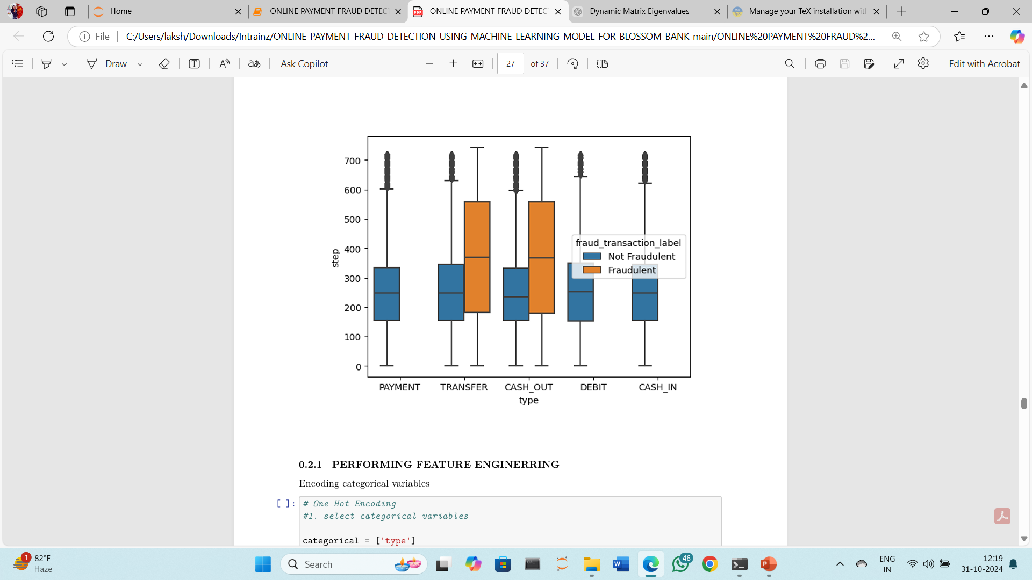
VISUALIZATION
The Decision Tree model with default parameters yields 99.96% accuracy on training data.
Precision Score: This means that 82% of all the things we predicted came true. that is 82% of clients transactions was detected to be a fraudulent transaction.
Recall Score: In all the actual positives, we only predicted 82% of it to be true.
Random Forest Tree model with default parameters yields 99.97% accuracy on training data.
Precision Score: This means that 99% of all the things we predicted came true. that is 99% of clients transactions was detected to be a fraudulent transaction.
Recall Score: In all the actual positives, we only predicted 81% of it to be true.
We explored correlation where it shows the relationships between variables(features) and how close they are related to each other. From the chart, we can see that balance before and after transaction are highly correlated compared to others.
Both the Decision Tree and Random Forest models outperform the Logistic Regression and K-Nearest Neighbors model by a wide margin. Since they both have similar recall scores, we should perform a cross-validation of the two models so we may declare which is the best performer with more certainty.
Conclusion
Upon training and evaluating our classification model, we found that the Random Forest model performed the best by a narrow margin.
Therefore, Random Forest performs best with recall cross-validation accuracy of 87% which is important for our problem statement where false negative is our priority

Slide 7
CONCLUSION/RECOMMENDATION
Random Forest Classifier model should be deployed by bank because for this business problem, recall score is more relevant because it measures how many of the actual fraudulent payments the model identified as fraud.
Transaction History and Frequency - if unaccounted transactions occurs frequently bank should confirm genuinity of the transaction with the customer
Repeated wrong PIN or Password – Bank should halt the transaction and alert the customer immediately.
Make customers to change PIN or password often
Instruct user to use own mobile or computers while doing transactions to avoid phishing attacks
Increased cybersecurity for banking websites and mobile applications
Bank should enable Two factor authentication for transaction
Ensure that bank hire a data engineer that will ensure the dataset is accurate, balanced for proper EDA as there are too many outliers in this data set. This will enable the business to build machine learning models that predict outcomes more accurately with better performance.

Slide 8
THANK YOU!!!

